Slide 1
BrainCloud

Slide 2
Methods

Slide 3
Methods
Number of genes mapping
[1] "number of genes in gene_list=gene_associated.txt mapping 301, out of 455 genes"
[1] "number of genes in gene_list=gene_nearest.txt mapping 181, out of 262 genes"
[1] "number of genes in gene_list=gene_prioritization.txt mapping 34, out of 42 genes"

Slide 4
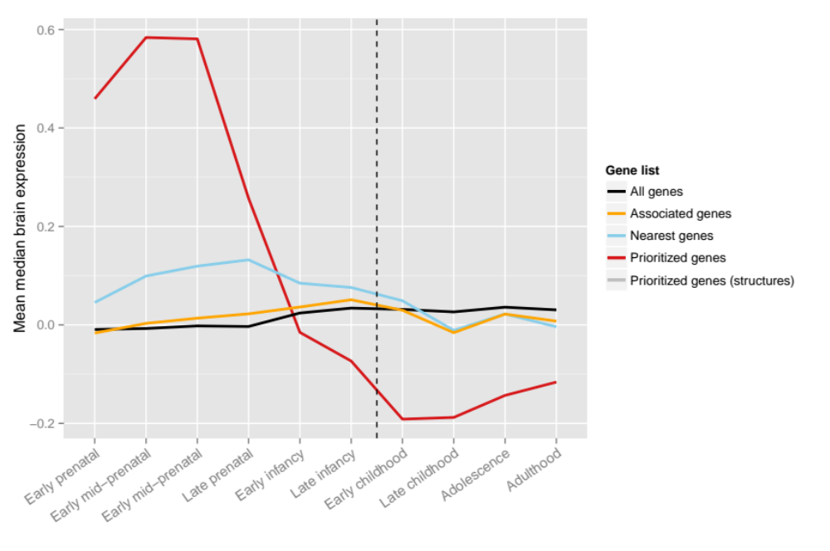
Time Series – release 2

Slide 5
Time Series – No Structure – release 2

Slide 6
Time Series SCZ

Slide 7
Release 2
Statistics: prenatal vs postnatal
> fit1 <- t.test(mean~natal, data=df.natal.gene.mean, alternative="less", paired=TRUE) # OBS: EAv2 is testing "less" (SCZ was testing alternative="greater")
> fit1
Paired t-test
data: mean by natal
t = -4.8688, df = 33, p-value = 1.357e-05
alternative hypothesis: true difference in means is less than 0
95 percent confidence interval:
-Inf -0.4777046
sample estimates:
mean of the differences
-0.7322204
> fit1$p.value
[1] 1.357027e-05
> ### calculation odd's ratio
> df.or <- ddply(df.natal.gene.mean, .(natal), summarise,
+ group_mean=mean(mean, na.rm=T))
> df.or
natal group_mean
1 postnatal -0.1370256
2 prenatal 0.5951948
> or_log2_corrected <- (2^df.or[df.or$natal=="prenatal","group_mean"]-1)/(2^df.or[df.or$natal=="postnatal","group_mean"]-1)
> #formula: or = ((2^mu1)-1)/((2^mu2)-1)
> or_log2_corrected
[1] -5.636116

Slide 8
Release 2
Identifying most highly expressed stage
stage mean_stage sd_stage
1 s2b 0.66058782 1.0091740
3 s3b 0.61936496 0.8225450
2 s3a 0.58014505 0.7699987
4 s5 0.20695879 0.6197486
5 s6 -0.01888124 0.3715160
6 s7 -0.08972150 0.4001480
10 s11 -0.14522331 0.4265458
9 s10 -0.15316286 0.3921978
7 s8 -0.16992946 0.3890239
8 s9 -0.18611025 0.3772048
testing for difference to other stages
stage V1
2 s3b 0.3062586
1 s3a 0.1178904

